Slide 1

Interactive Commodity reports for
Agricultural Marketing(AgMRC)
Project Advisor: Rakesh Shah
Graduate Fellow: Muskan Tantia
Interns: Joel Martin, Maxwell Skinner, Tanishq Jain
1

Slide 2


Slide 3

AgMRC commodity reports can be used as preliminary research in order to determine current production, market analysis, demographic data, and price points Background
Background
Initially, the reports were build using PHP as non-customizable pdf format
The visualizations were pre-generated and added to report with no way to interact based on the requirement
There was a need to develop a platform to make it more interactive with export as pdf functionality
These reports can be useful in applying for a wide variety of grant funding, financial institutional loans, etc.
Objective
Outcome
Develop end to end automated report:
creation of two commodity reports(Egg and Beef)
data discovery to find data sources to create finer detailed final product
explore new and interesting infographic techniques applicable to increased understanding
streamline all reports with better filters to handle differing data based on geography and year
Use tools like R for data manipulation
Reports can be used as a starting point for figuring out production and market trends
Interactive visualizations can be helpful when applying for a range of grants and fundings
Measurable and interesting KPIs (production by state, Avg. expenditure, nearby Food hubs etc.)
Better search and filtering, can be downloaded as pdf

Slide 4
Data Sources
01
03
05
AgMRC
USDA Local food Directories
ESRI Consumer Spending/
demographics data
USDA Agricultural Marketing Service
National Oceanic and Atmospheric Administration
Data Axle Genie
02
04
06

Slide 5

Egg Commodity Report
What does the Report Include?
Cover Page​
This page includes overview of the Eggs and Resources​
Market and Harvest Trends​
It includes information on Production, sales, price etc.,​
Market Consumption Profile​
It has yearly egg expenditure, changes and comparison with national average​
Demographic Profile – Part 1 & Part 2​
It has demographics information like population, race, monthly precipitation info of Iowa, National Level Local Food Market Locations and statewide agricultural export percentages

Slide 6
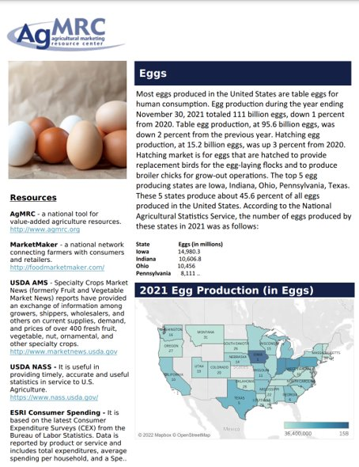
Cover Page
Eggs Overview
Egg production heat map
Resources

Slide 7
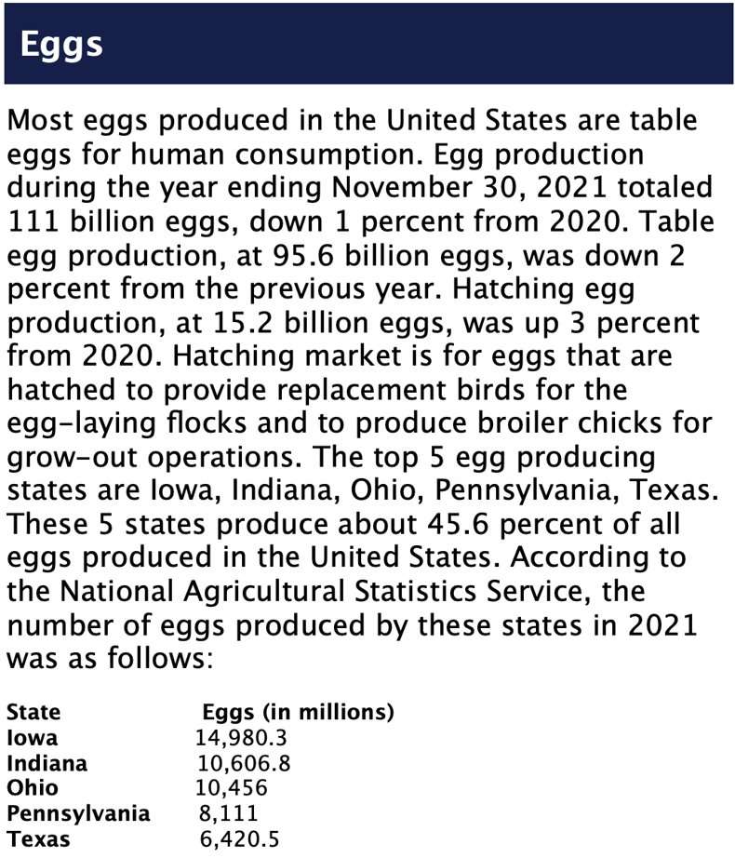
Eggs Overview
One Large boiled egg has 78 calories
It is a highly nutritious food
High digestibility and Affordable Price.
Table eggs and Hatching eggs
Compares 2021 egg production with that of 2020
Top 5 egg producing states

Slide 8
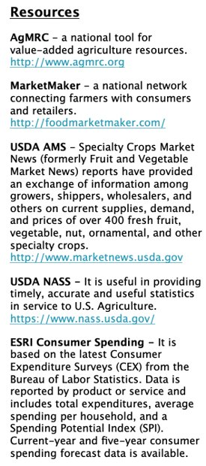
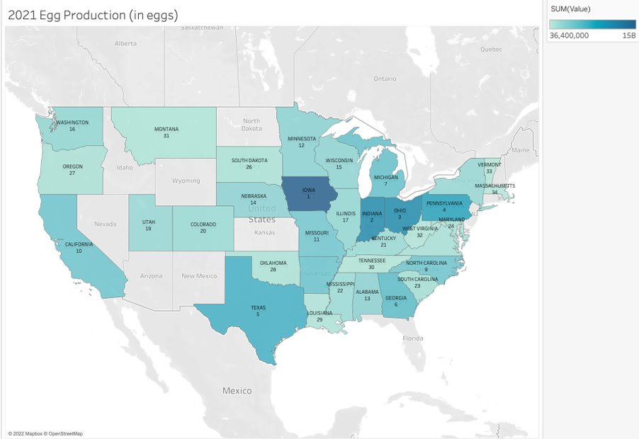
Resources and Heat Map
Data is collected from USDA National Agricultural statistics service
Both census and survey data is used for the Report
No County Level data
For this report we relied on National and State level data.

Slide 9
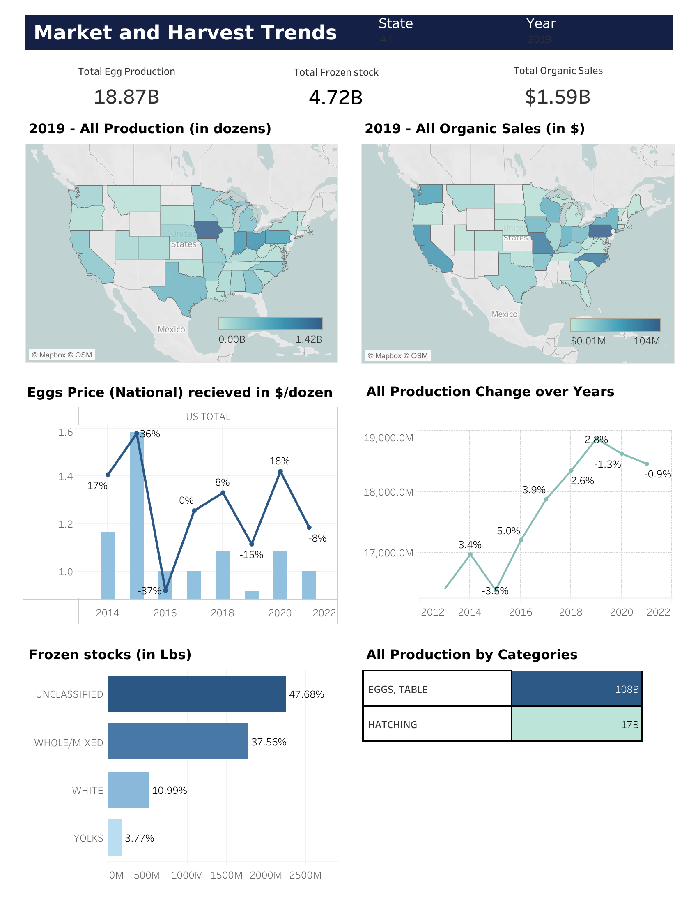
Market and Harvest Trends
Analyzing Production Trends(in dozens by states and over the years)
Production in dozens
Production change over years
Production by categories
Organic Sales(in $)
The Sales Data is available from 2011 to 2019
US Total Statistics
Egg price received in $/dozen over the years
Frozen Stocks

Slide 10
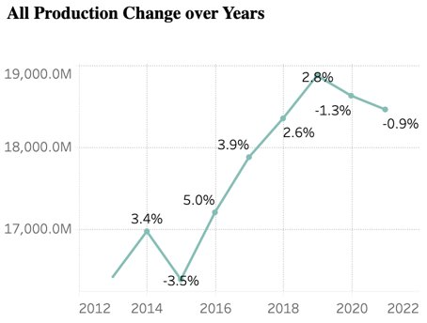
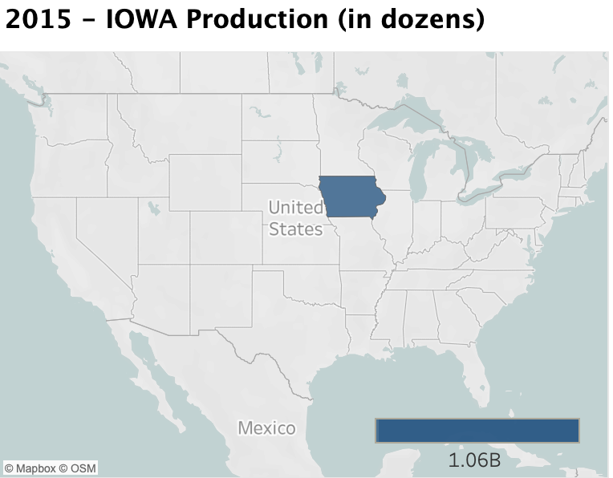
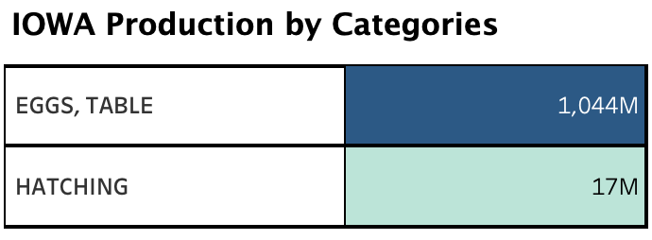
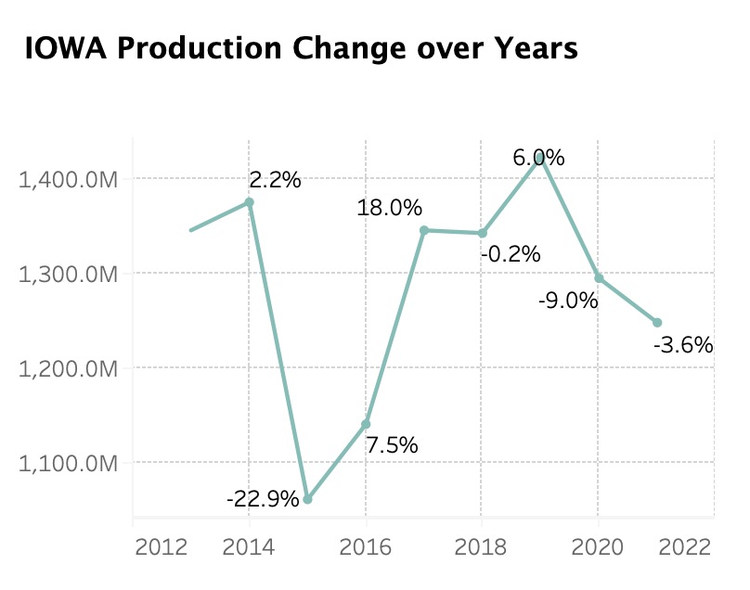
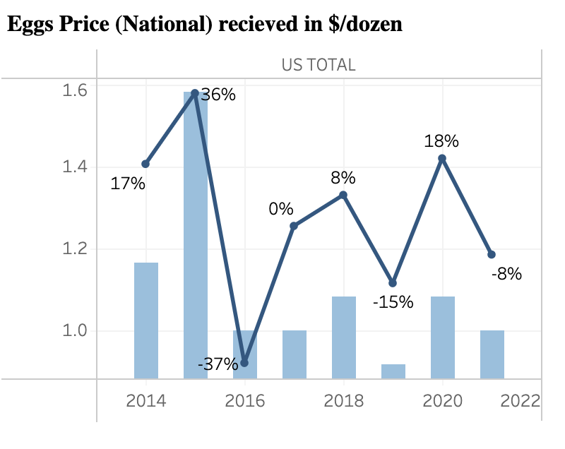
Analyzing Production trends

Slide 11
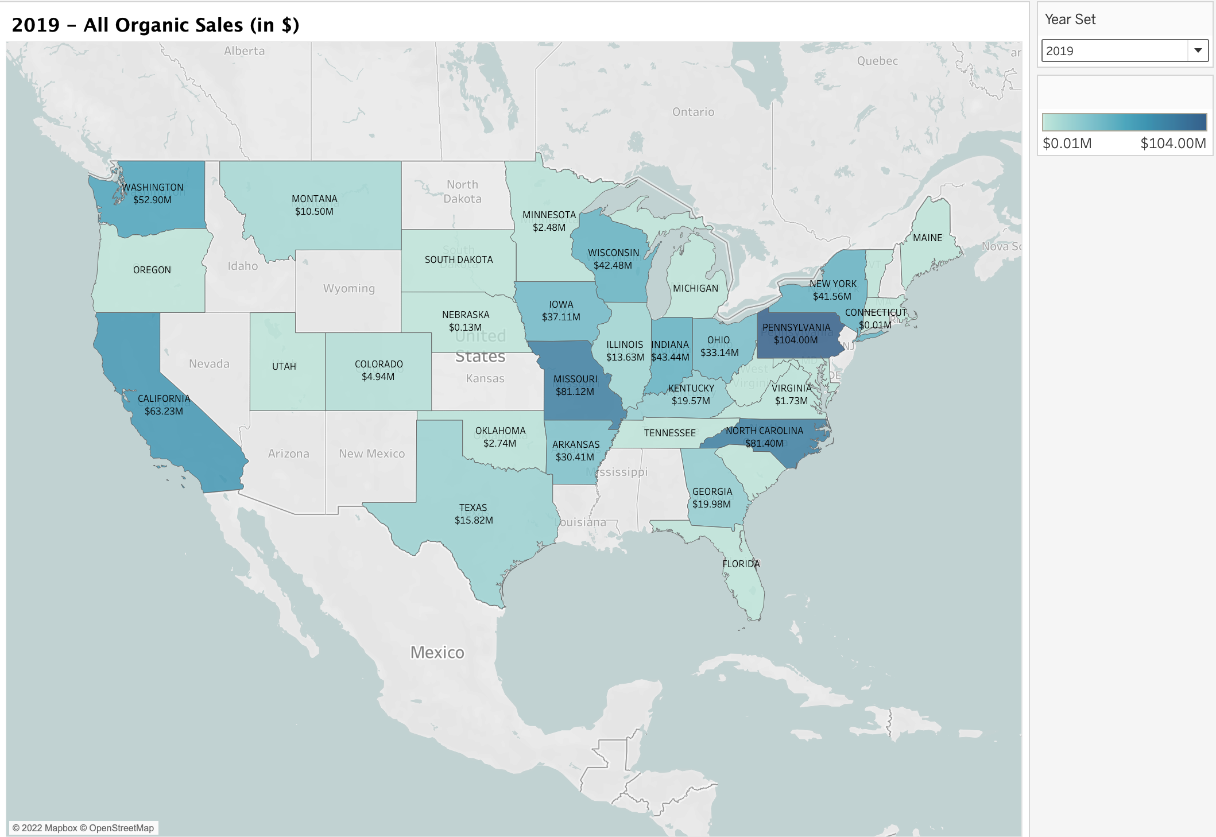
Organic Sales
Organic sales are from USDA Census of Organics
Pennsylvania recorded the highest organic sales worth $104 million for the year 2019 followed by North Carolina worth $81.4 million and Missouri worth $81.12 million

Slide 12
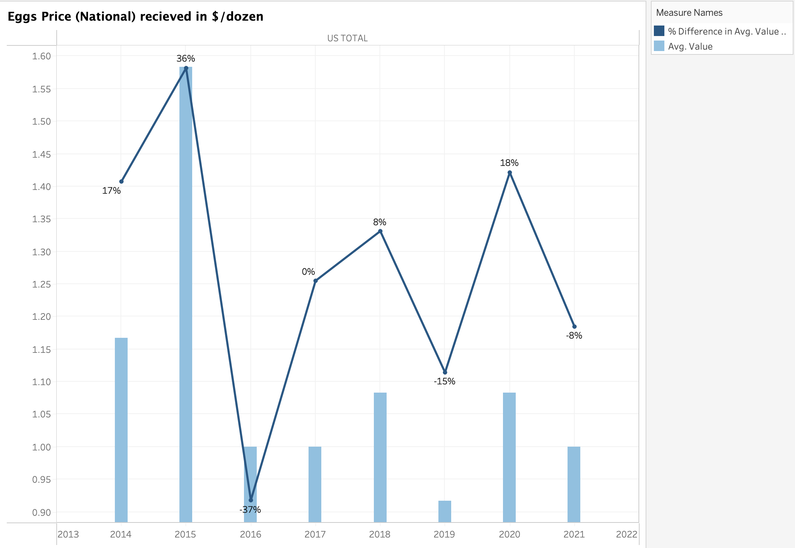
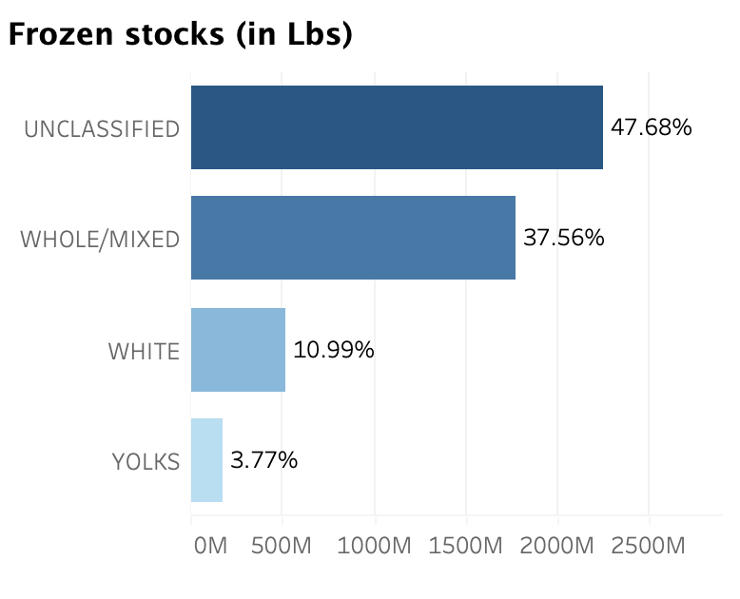
US Total Statistics

Slide 13
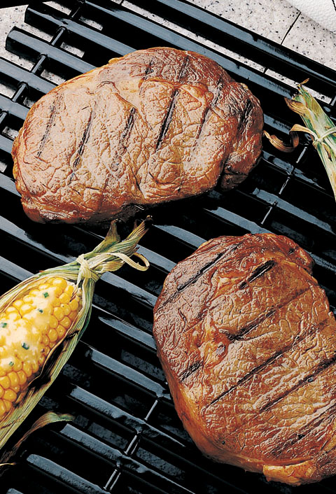
Beef Commodity Report
What does the Report Include?
Cover Page​
This page includes overview of the Beef and Resources​
Market and Harvest Trends​
It includes information on Production, sales, price etc.,​
Market Consumption Profile​
It has yearly beef expenditure, changes and comparison with national average​
Demographic Profile​
It has demographics information like population, race, monthly precipitation info of Iowa, National Level Local Food Market Locations and statewide agricultural export percentages

Slide 14
Data Source
National Oceanic and Atmospheric Administration: for state historical weather data Link: https://www.noaa.gov/
USDA Local Food Directories: for locations of farmer’s markets, food hubs
Link: https://www.ams.usda.gov/local-food-directories/farmersmarkets
USDA Quickstats: for survey and census data
Link: https://quickstats.nass.usda.gov/

Slide 15
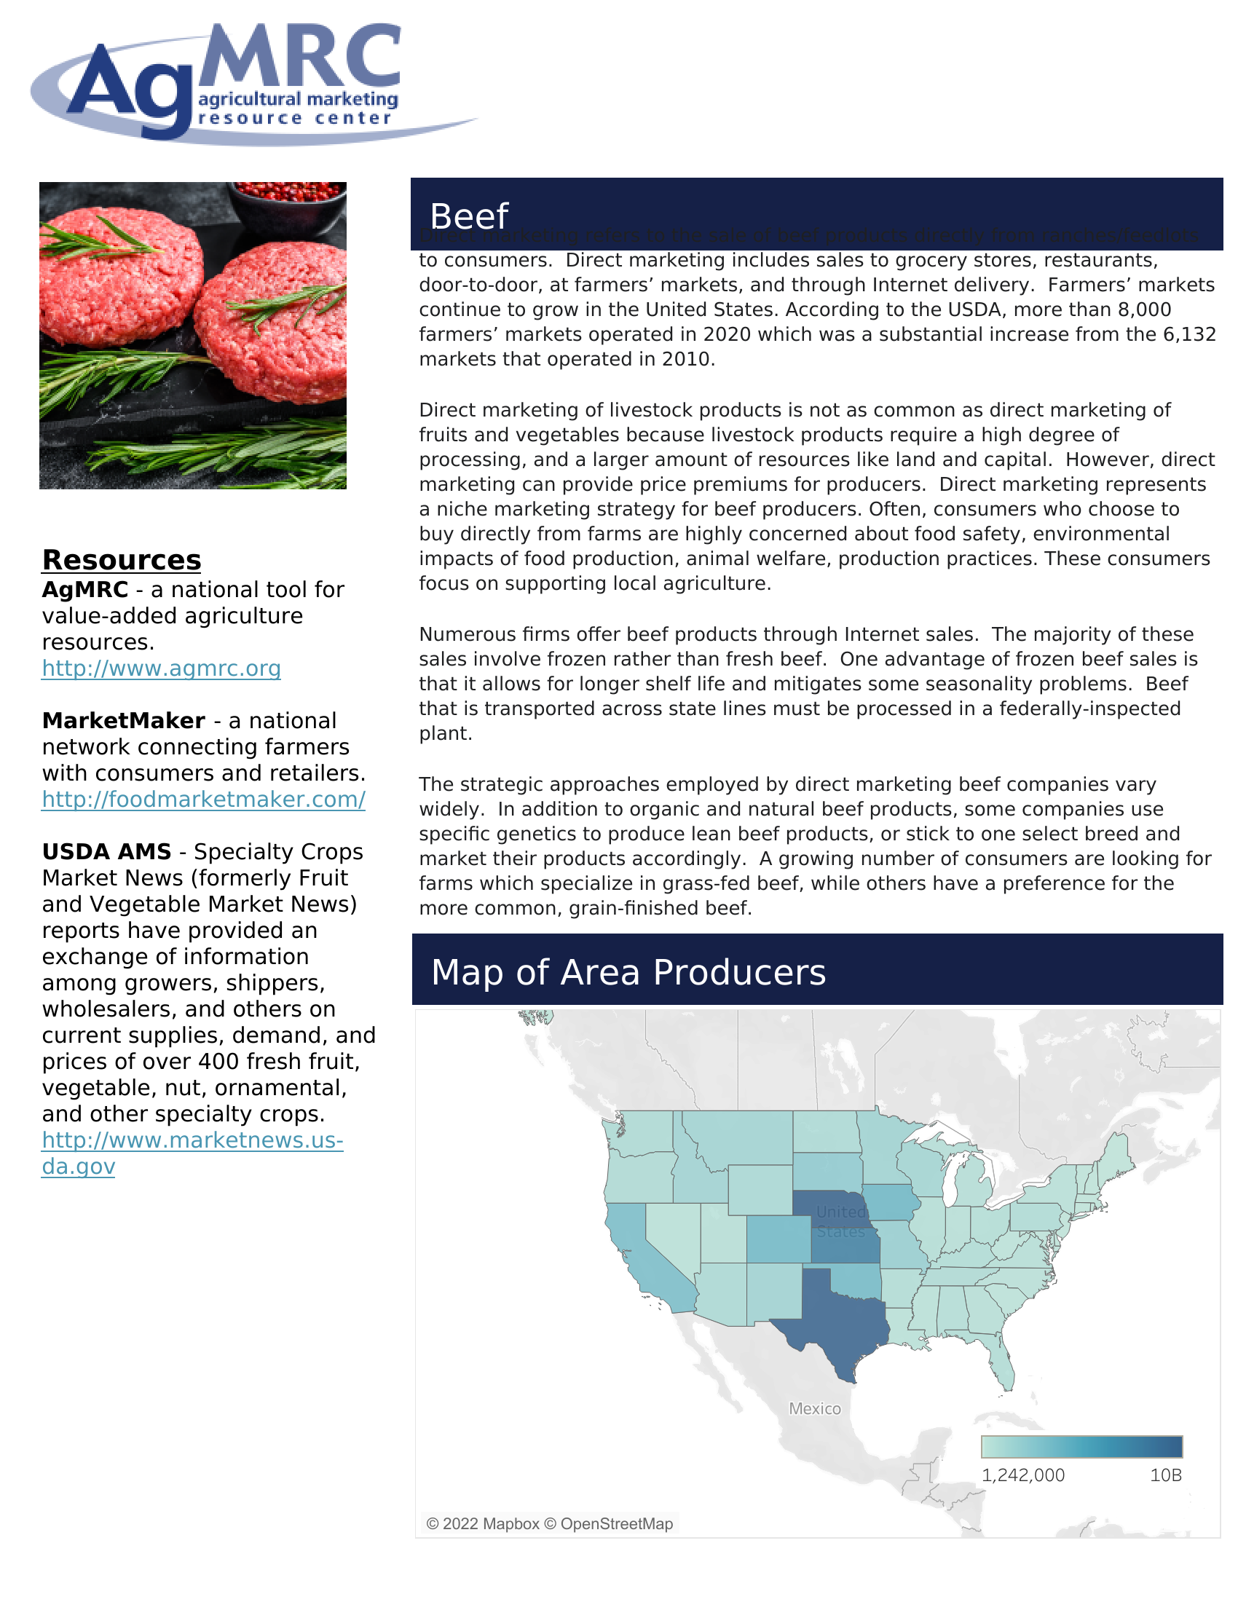
Cover Page
Contains primarily USDA census and survey data
Cover gives an overview of the commodity and resources provided by AgMRC
Map of Area Producers graph features a production heat map by state of cattle in the U.S.

Slide 16
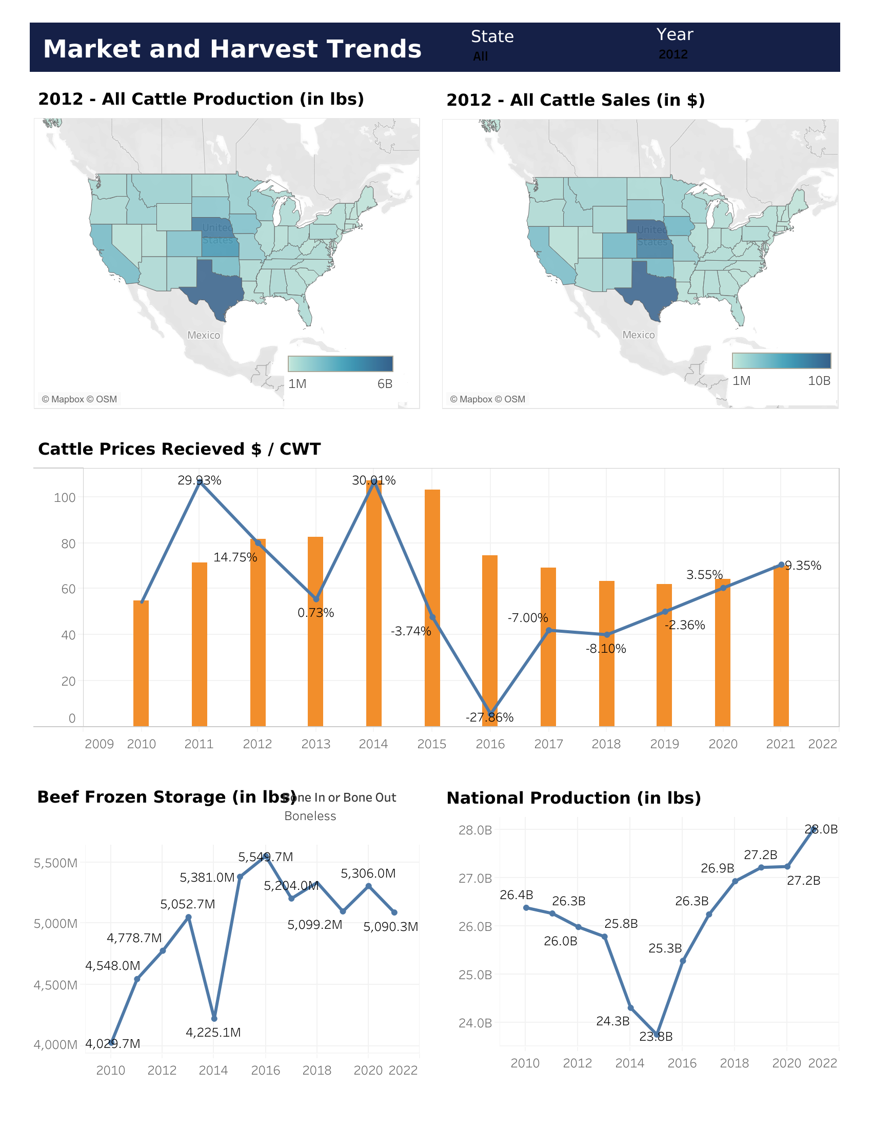
Market and Harvest Trends
National Cattle Statistics
Cattle Production by state (in lbs)
Cattle Sales by state (in $)
Beef Production nationally (in lbs)
Cattle Prices $ / CWT from 2010 - 2021
Beef Frozen Storage (in lbs)

Slide 17
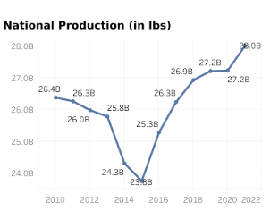
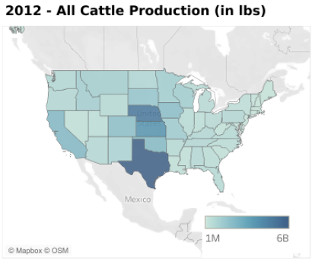
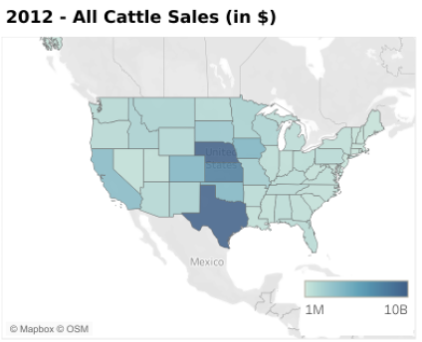
National Cattle Statistics

Slide 18
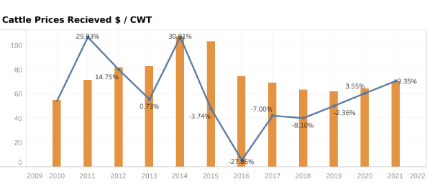
Cattle Prices $ / CWT from 2010 - 2021

Slide 19
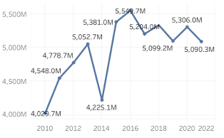
Beef Frozen Storage (in lbs)
This graph is the total amount of beef stored in the U.S. from 2010 to 2022. Combines both boneless and bone-in metrics. Good measure of how much beef is produced as well as how much it is being consumed

Slide 20
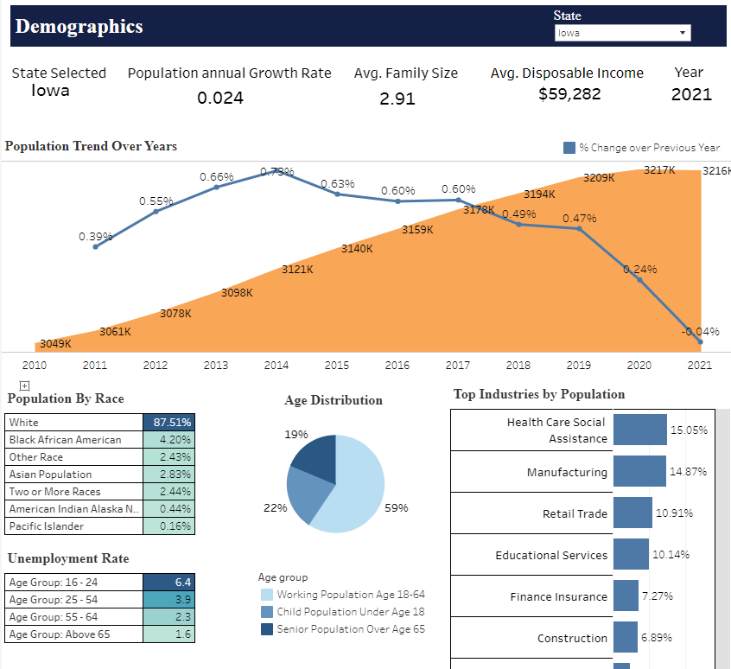
Demographic Profile – Part 1
Population Trend from 2010 - 2021
YOY Percentage change
Population Distribution by Race and Age
Household Income and Unemployment Rate
Top Industries by Population

Slide 21
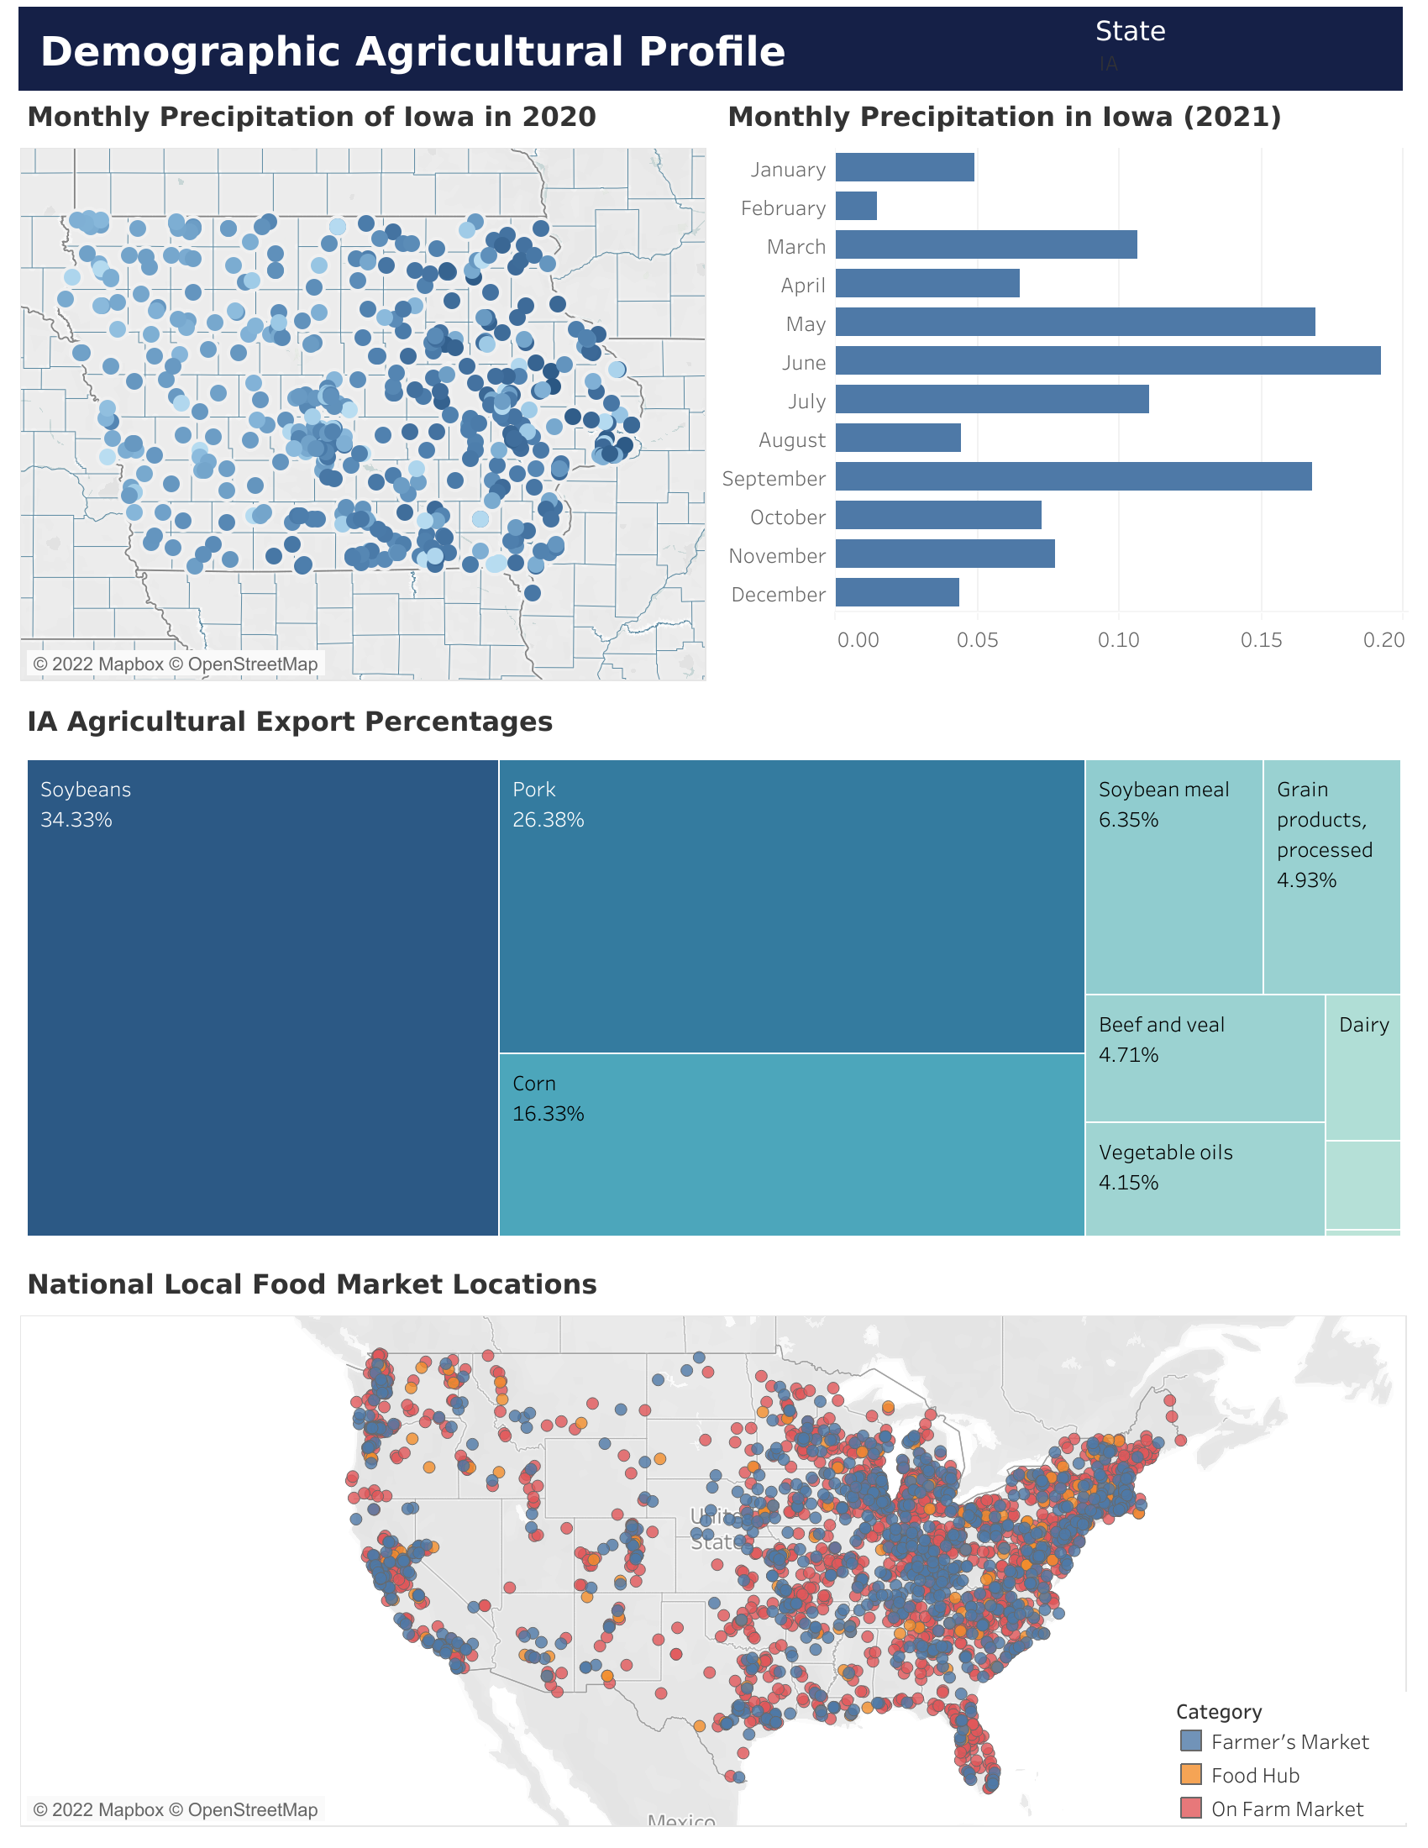
Demographic Profile – Part 2
State Agricultural Percentages
Graph that divides the certain commodities a state exports into percentages
Monthly Precipitation of States by Month and Geographic Location
Contains NOAA weather station data that is aggregated by state. Also includes a bar chart that measures the level of precipitation a state receives per month
National Local Food Market Locations
Map of every local food market in the United States

Slide 22
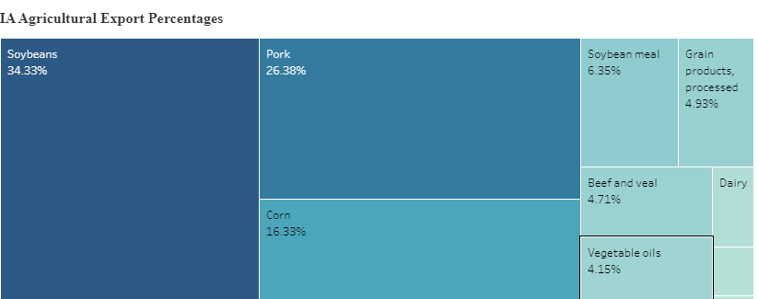
State Agricultural Percentages

Slide 23
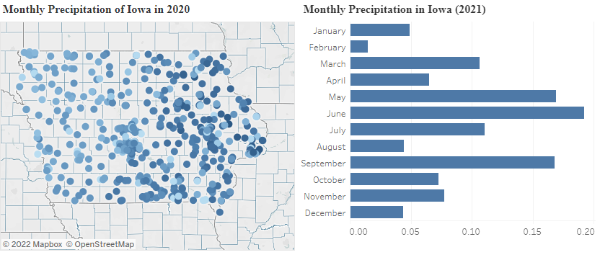
Monthly Precipitation of States by Month and Geographic Location

Slide 24
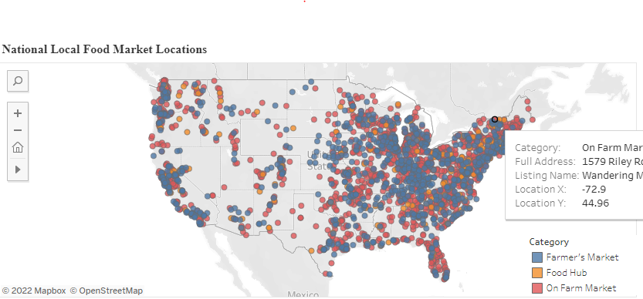
National Local Food Market Locations

Slide 25
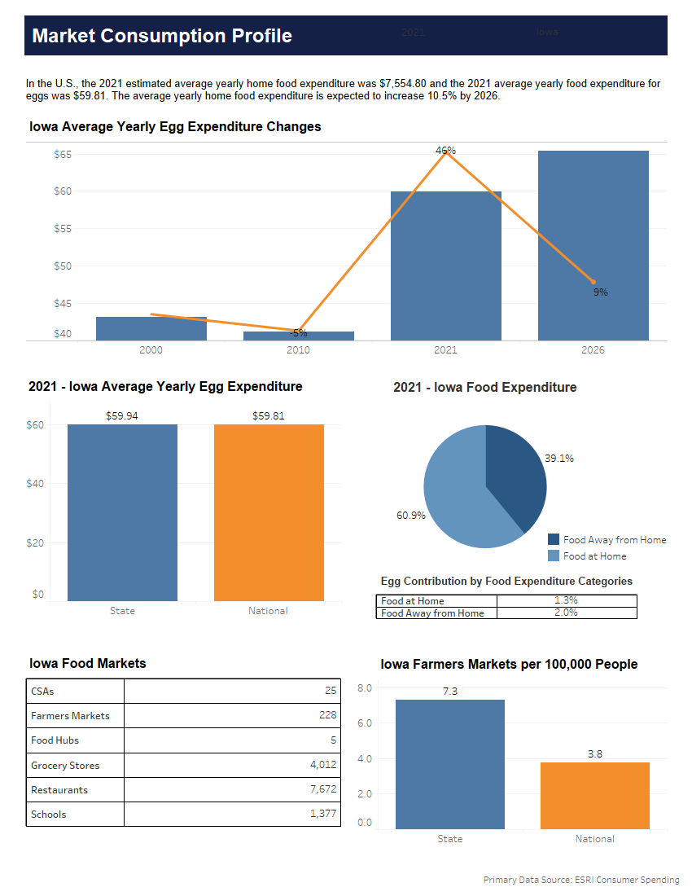
Market Consumption Profile
Data Sources
Contains primarily ESRI consumer spending data
Some secondary data sources include USDA Agricultural Marketing Service, CDC State Indicator Report and Data Axle Genie
Data Transformation
Graphs

Slide 26
Data Sources
CDC State Indicator Report:
The report shows the status of 10 indicators of fruit and vegetable access and production for all 50 states and the District of Columbia
Used to find number of food hubs
Food Hub - A centrally located facility with a business management structure facilitating the aggregation, storage, processing, distribution, and/or marketing of locally/regionally produced food products
Data Axle Genie:
Tool for accessing business and consumer leads.
Used to find number of grocery stores and restaurants.
ESRI:
Esri U.S. Consumer Spending data is based on the latest Consumer Expenditure Surveys (CEX) from the Bureau of Labor Statistics
Data for years 2000, 2010, 2021, and 2026
Contains hundreds of details about products and services
Used egg and beef expenditures and food expenditures at and away from home
USDA Agricultural Marketing Service (AMS):
The Agricultural Marketing Service (AMS) administers programs that create domestic and international marketing opportunities for U.S. producers of food, fiber, and crops
Used this data to find number of community-supported agricultures (CSAs) and farmers markets

Slide 27
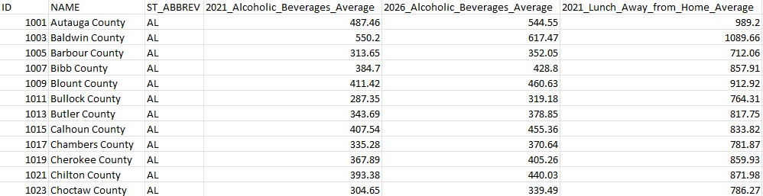
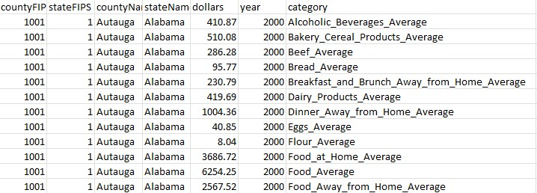
Data Transformation
Before (Wide Format)
ESRI:
Data was in a wide format.
Also created long format.
Updated old category names to match new category names.
Changed state abbreviations to full names.
USDA Agricultural Marketing Service (AMS):
CDC State Indicator Report:
Data Axle Genie:
No manipulation were done to these data sources since they were reused from previous team’s work
After (Long Format)

Slide 28
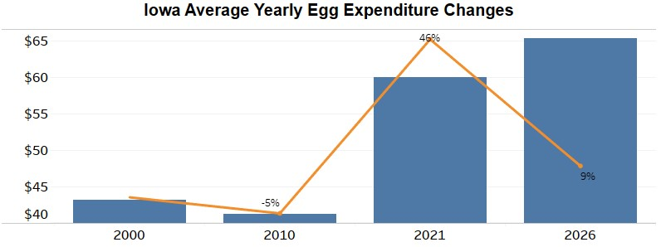
Graph
Average Expenditure Over Years
Looks at the difference in a commodities expenditures from previous decades to get a sense of market trends
Notes:
This graph is useful to see what the market trends are for a commodity.

Slide 29
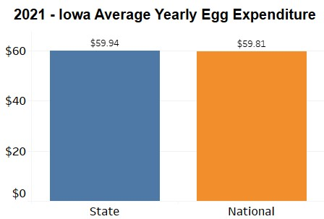
Graph
Average Expenditure for 2021 State Vs National
Compares a particular states average expenditure for the given commodity to the national average for the selected year
Notes:
This graph is helpful in determining how state commodity expenditures are comparing to the national average.

Slide 30
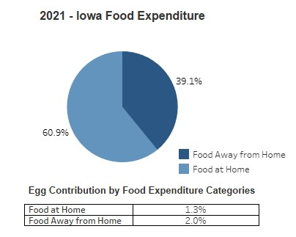
Graph
Egg Contribution in Food Categories
Compares the 2021 away/at home food expenditure by state. Can also see the contribution the commodity had to those categories
Notes:
Useful to see how much have a commodity makes up food expenditures.

Slide 31
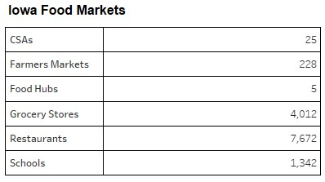
Graph
Count of Iowa Food Markets by Category
Compares different type of food markets

Slide 32
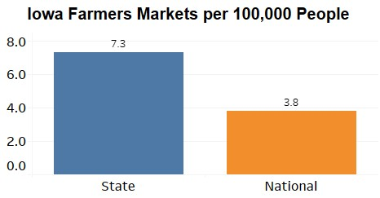
Graph
Farmers Market State Vs National
Compares a state's farmer markets per 100,000 people to the national average

Slide 33
LIVE DEMO

